Slide 1
Information Visualization Session 2: Asking the Question
Matthias Shapiro
@politicalmath
matthias.shapiro@outlook.com

Slide 2
Agenda
Finding the appropriate data
Organize your data
Basic charting

Slide 3
Agenda
Excel is your new best friend

Slide 4



Static Data Sets
Complete downloadable files
Usually in Comma Separated Value (csv) format or Excel files
Specific data, limited to a topic

Slide 5




Custom Data Sets
Data saved in online databases
Accessible through online forms or API calls
Accessing APIs requires some programming experience

Slide 6
pick a topic for your story

Slide 7
(soft skill stuff)

Slide 8
Soft skill search terms

Slide 9
find the data

Slide 10
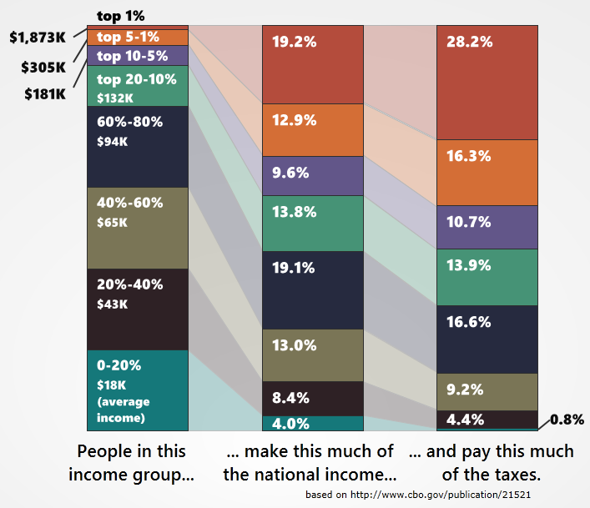
Economic Data
FRED – Federal Reserve Bank
of St. Louis Economic Data
http://research.stlouisfed.org/
CBO.gov
http://www.cbo.gov/

Slide 11
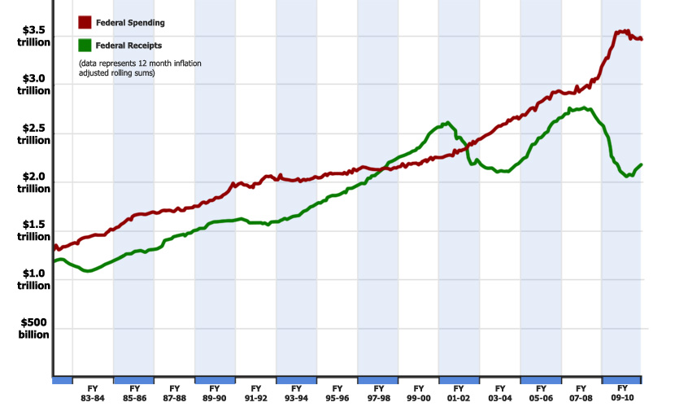
Federal Spending Data
Monthly Treasury
Statement
http://www.fiscal.treasury.gov/
fsreports/rpt/mthTreasStmt/
backissues.htm
CBO.gov
http://www.cbo.gov/

Slide 12
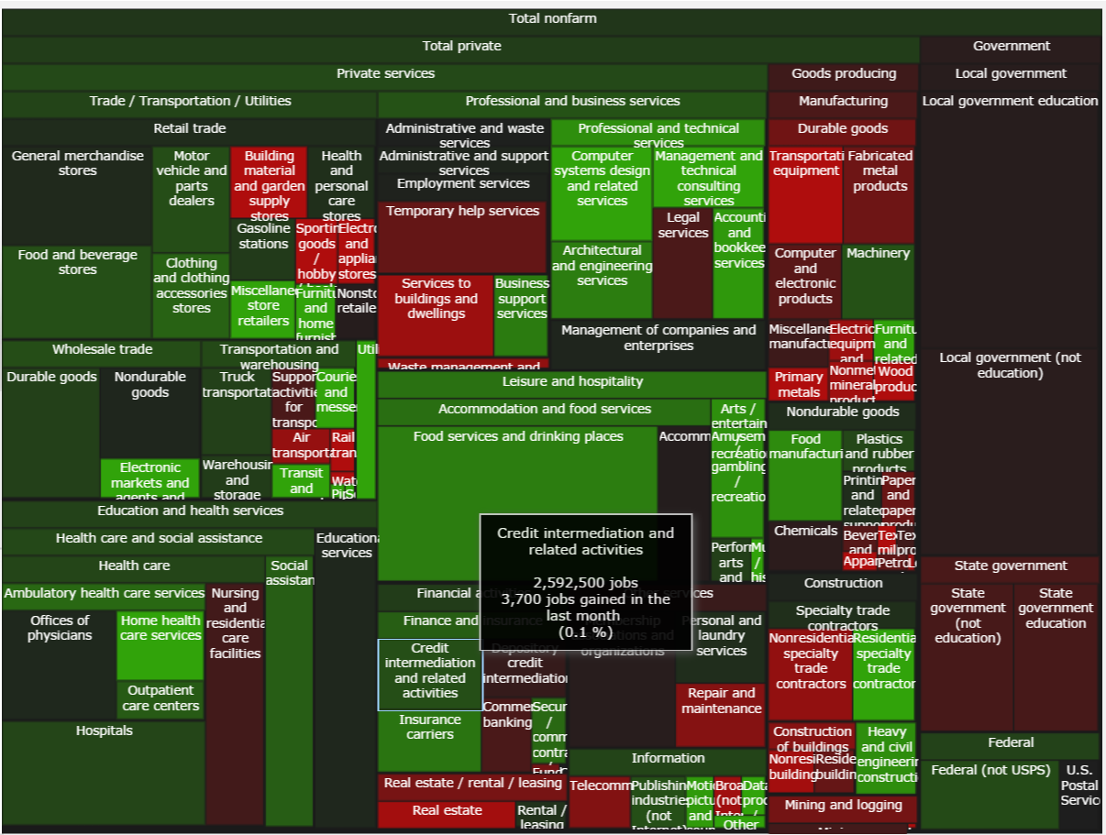
Employment Data
Bureau of Labor Statistics
http://www.bls.gov/data/
http://politicalmathblog.com/BLS/2012/08/

Slide 13
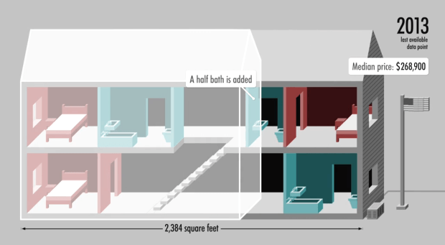
Demographics Data
Census.gov
http://www.census.gov/
data.html
http://money.cnn.com/interactive/pf/40-years-american-home/

Slide 14
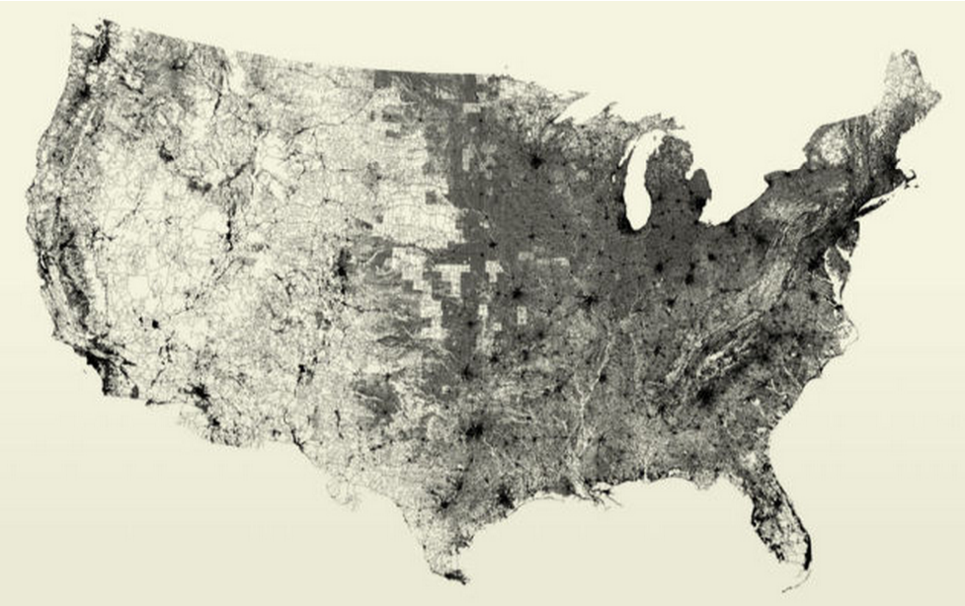
All the Data
https://www.data.gov/open-gov/

Slide 15
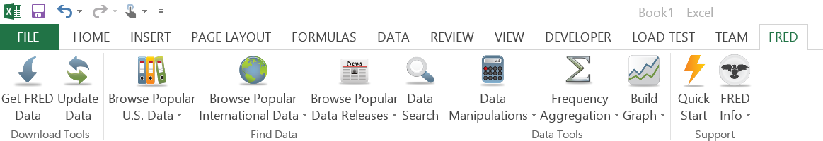
FRED Data – Excel Add-In
http://research.stlouisfed.org/fred-addin/

Slide 16
APIs
http://www.opensecrets.org/resources/create/
http://developer.nytimes.com/docs
http://sunlightfoundation.com/api/

Slide 17
You will need: Excel The interwebs

Slide 18
organizing your data

Slide 19
Organize In Excel
Calculating an average
Rolling averages
Transposing data
Copying values (not equations)
Exporting data
Sorting with Excel
Basic conditional investigation

Slide 20
Calculate an Average
=AVERAGE(A1:A12)

Slide 21
Rolling Sums / Averages
=SUM(A1:A12)
drag the formula down

Slide 22
Excel Syntax
Using the ‘$’ operand.
‘$’ means “stop moving”

Slide 23
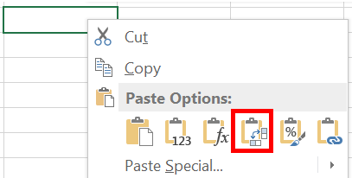
Transposing Data
Copy-Paste data to swap rows/columns

Slide 24
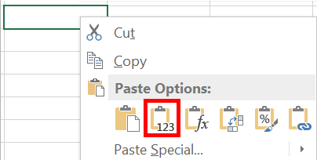
Copying Values
Strip out formulas from cells
Retain only the calculated values

Slide 25
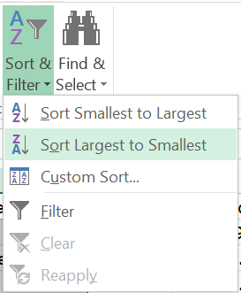
Sorting in Excel
Select a column
“Sort & Filter”
Always “expand selection”

Slide 26
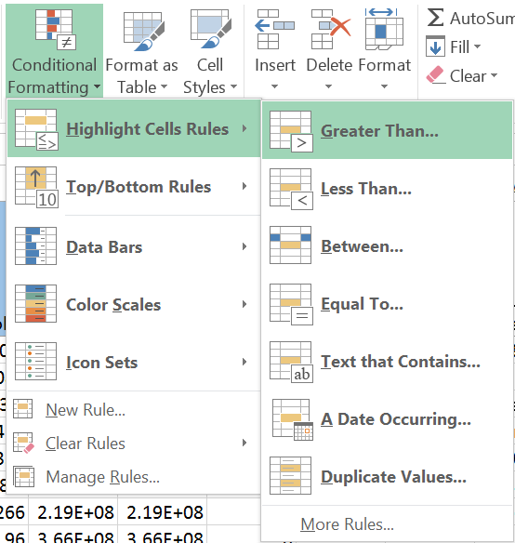
Conditional Investigation
Highlight cells with certain data

Slide 27
Conditional Investigation
Using Color Scales

Slide 28
Exporting Data
Using the helper Excel files

Slide 29
basic charting

Slide 30
Simple Excel charting

Slide 31
Additive charts

Slide 32
Pie Charts

Slide 33
Network Charts

